Slide 1
ML-based Intrusion Detection System
Presented by
Maryam Al Shami
Mohamad Al Adraa
Concordia

Slide 2
Outlines
Motivation
Problem
Proposed Solution
Data set
Methodology
Results
Conclusion
References
Concordia

Slide 3
Motivation
In 2023: 2.3 billion devices would be connected to the internet
Amount of traffic generated could reach petabytes
Cyber criminals will steal an estimated 33 billion records in 2023
Network Traffic prone to cyber attacks
  Security breach, or shut down network (Intrusion)
Concordia
Notes:
IDS: Monitoring system that detects suspicious activities and generates alerts when they are detected. Based upon these alerts, a security operations center (SOC) analyst or incident responder can investigate the issue and take the appropriate actions to remediate the threat.

Slide 4

Problem
Traditional detection mechanisms
  High false negative predictions rate
  Slow detection
Concordia
Notes:
false negative predictions: something is false when it is actually true

Slide 5
Proposed Solution
ML-based Intrusion Detection System
Fast
Detect malicious traffic by raising alarms
Report them to administrators
Take appropriate actions
Decreasing number of false negative predictions
Concordia

Slide 6
Data set
- Overview -
NSL-KDD dataset
Used in intrusion detection research
Consists of binary, numerical & categorical data
Dataset's input provided as a vector of 41 features
Labels distributed into 40 types of attacks
Concordia

Slide 7
Methodology
Data Preprocessing
Binary & Multi-class
Data Augmentation
Features Selection
Training & Testing
Concordia

Slide 8
Data Preprocessing
1

Slide 9
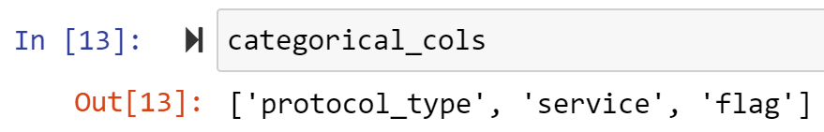
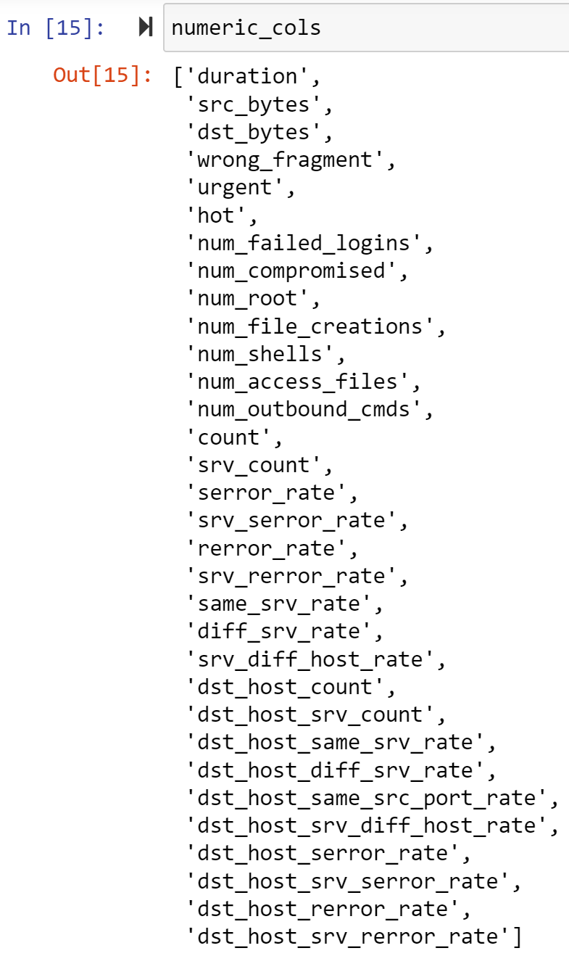
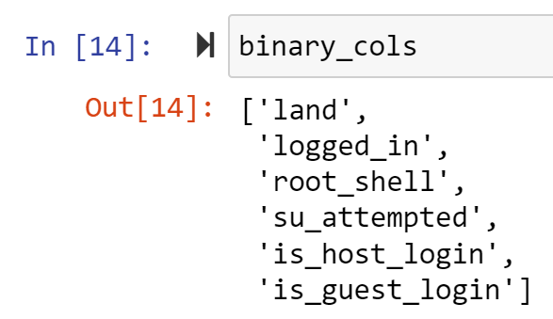
Data Analysis
Categorical
Numerical
Binary
Concordia

Slide 10
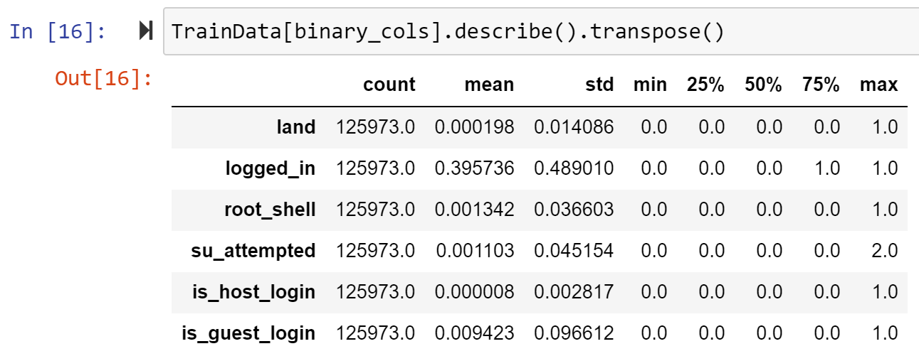
Data Analysis: Binary
Replace by 0.0
Concordia
Notes:
We replace

Slide 11
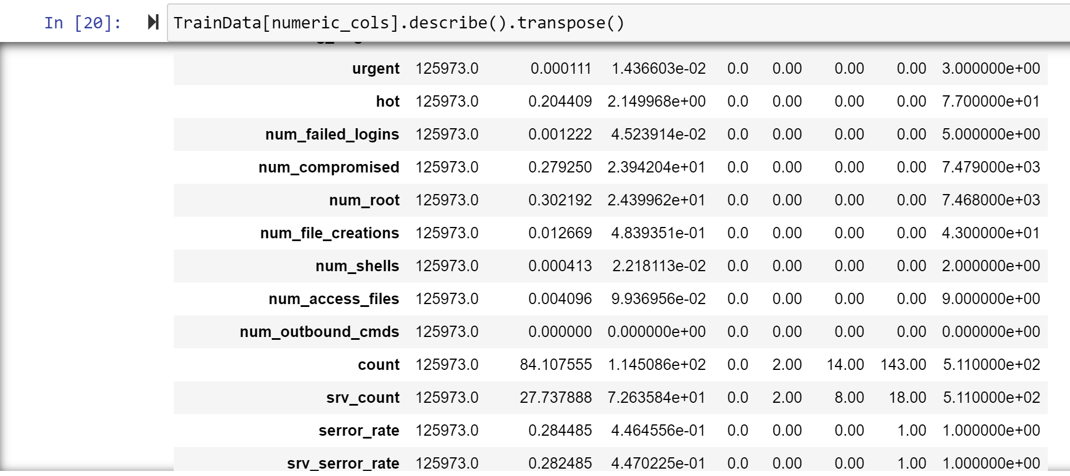
Data Analysis: Numerical
Drop
Concordia

Slide 12
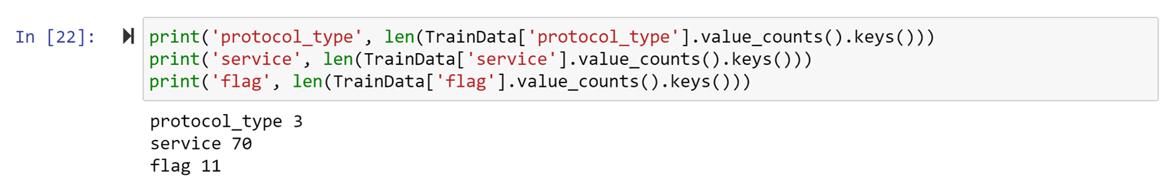
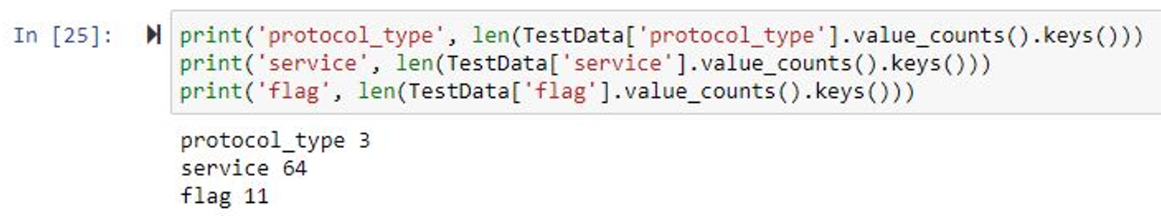
Data Analysis: Categorical
Concordia

Slide 13
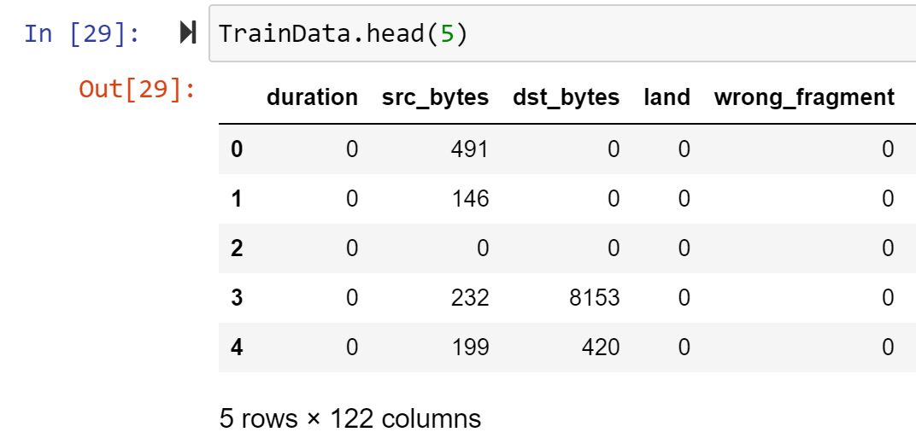
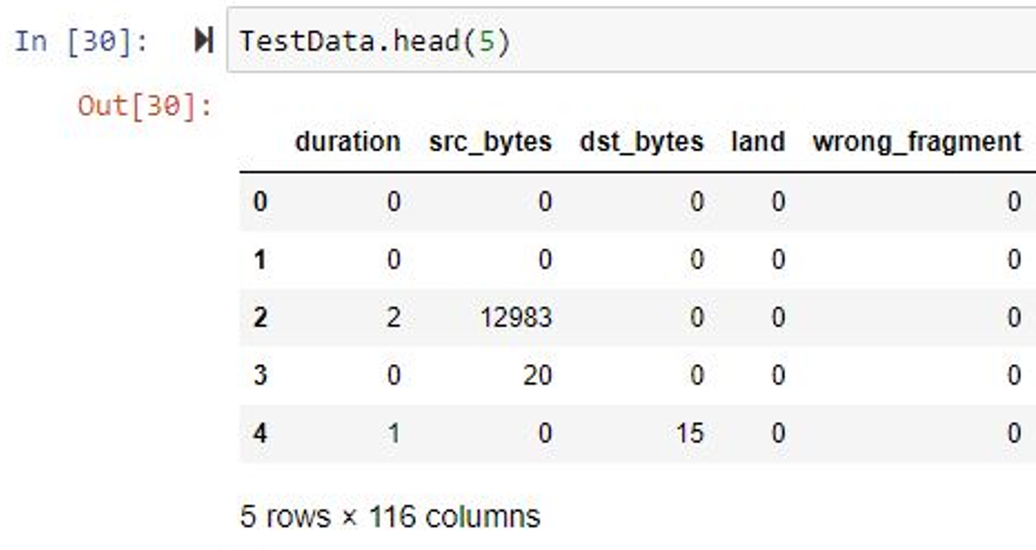
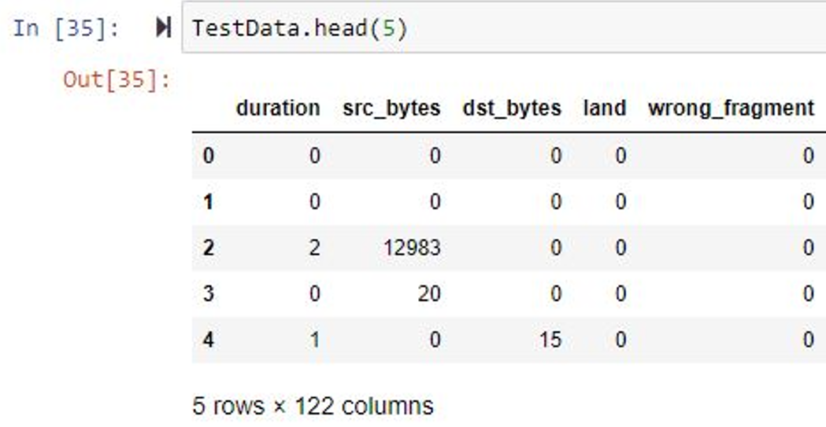
Encoding Categorical Features: OneHotEncoder
Adding the missing columns
Concordia
Notes:
Label encoding has the disadvantage that the numeric values can be misinterpreted by algorithms as having some sort of order in them. This ordering issue is addressed in another common alternative approach called ‘One-Hot Encoding’

Slide 14
Encoding Labels
DoS
Probe
R2L
U2R
back(359), land(7), neptune(4,657), apache2(737), pod(41), smurf(665), teardrop(12), udpstorm(2), processtable(685), worm(2), mailbomb(293) | Satan(735), ipsweep(141), nmap(73), portsweep(157), mscan(996), saint(319) | guess_passwd(1,231), ftp_write(3), imap(307), xsnoop(4), phf(2), multihop(18), warezmaster(944), xlock(9), snmpguess(331), snmpgetattack(178), httptunnel(133), sendmail(14), named(17) | Buffer_overflow(20), loadmodule(2), xterm(13), rootkit(13), perl(2), sqlattack(2), ps(15)
Concordia

Slide 15
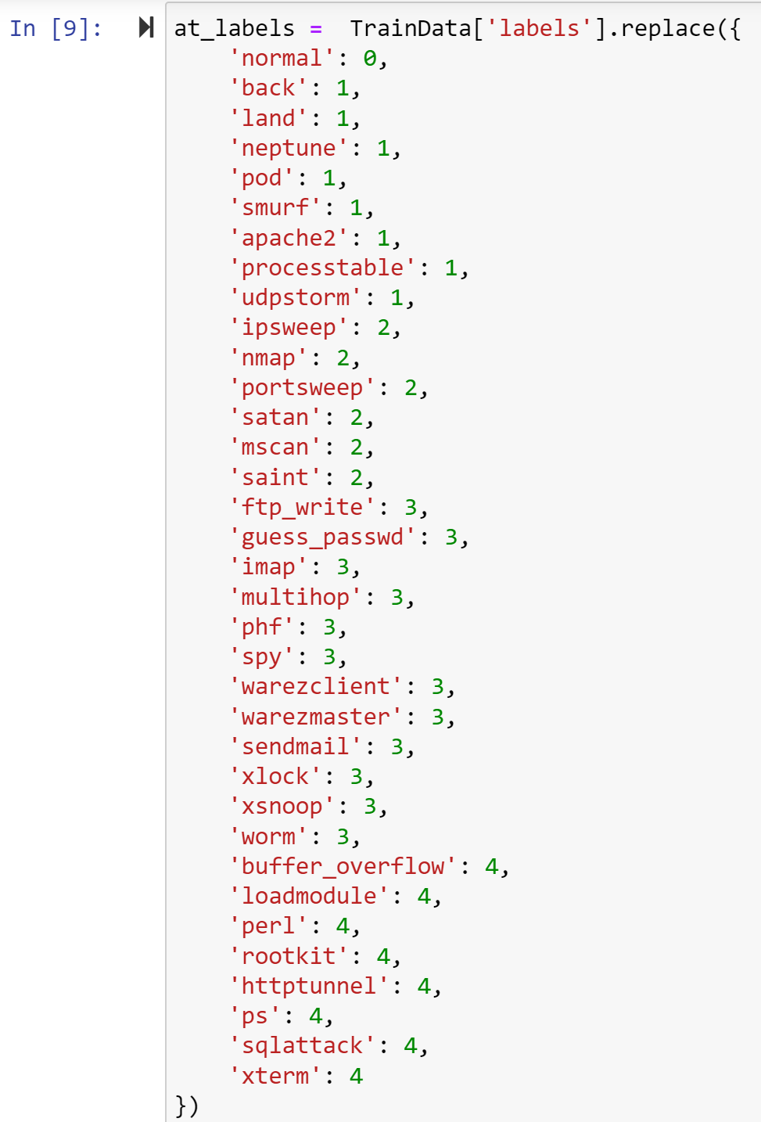
Encoding Labels: LabelEncoder
Normal = 0
DoS = 1
Probe = 2
R2L = 3
U2R = 4
Concordia
Notes:
Aim: categorize them into 4 attacks
Label Encoding refers to converting the labels into a numeric form so as to convert them into the machine-readable form

Slide 16
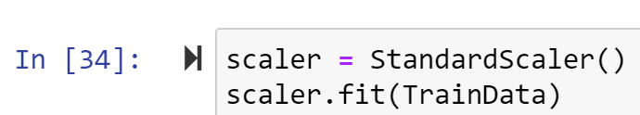
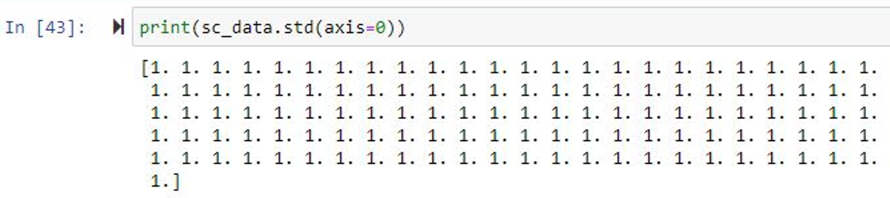
Scaling
Concordia
Notes:
Feature Scaling is a technique to standardize the independent features present in the data in a fixed range. It is performed during the data pre-processing to handle highly varying magnitudes or values or units.

Slide 17
Binary & Multi-class
2

Slide 18
Classification
Binary Problem
DoS & normal
Probe & normal
R2L & normal
U2R & normal
Multi-class Problem
Normal & DoS & R2L & U2R
Concordia

Slide 19
Data Augmentation
3

Slide 20
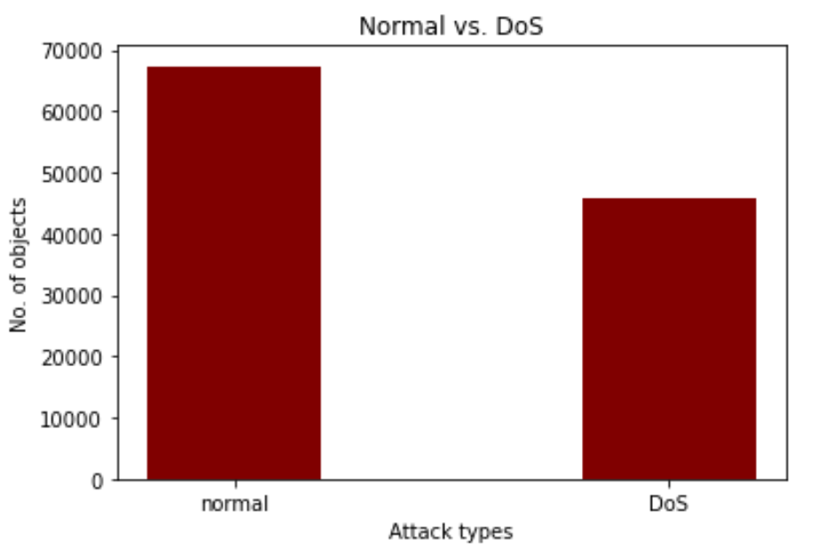
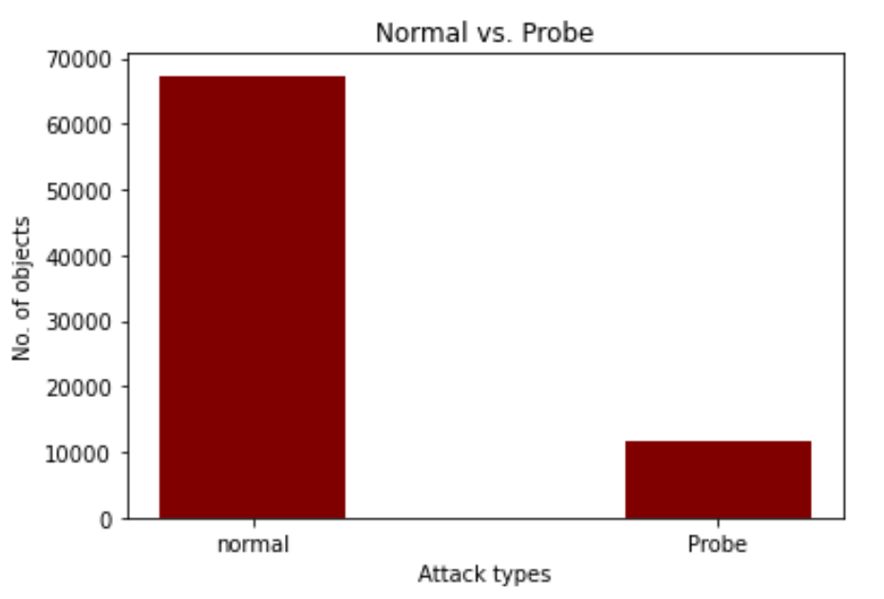
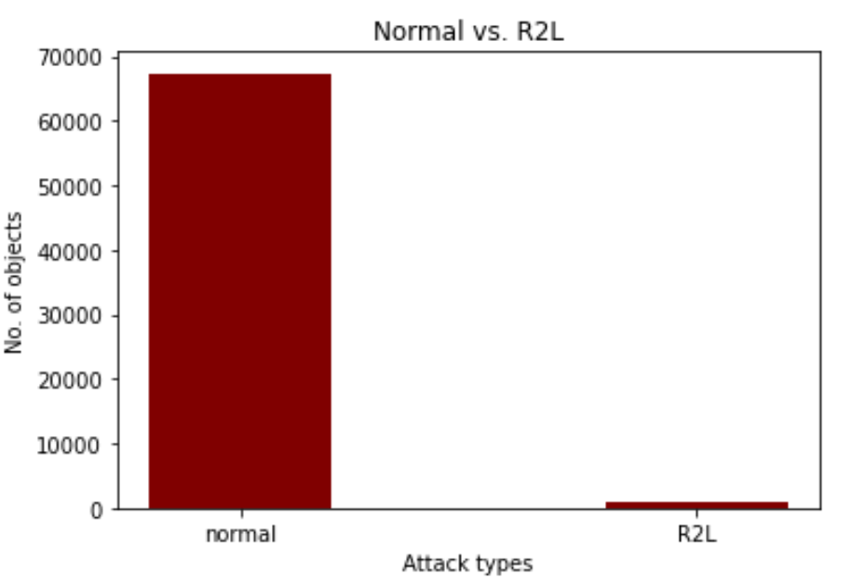
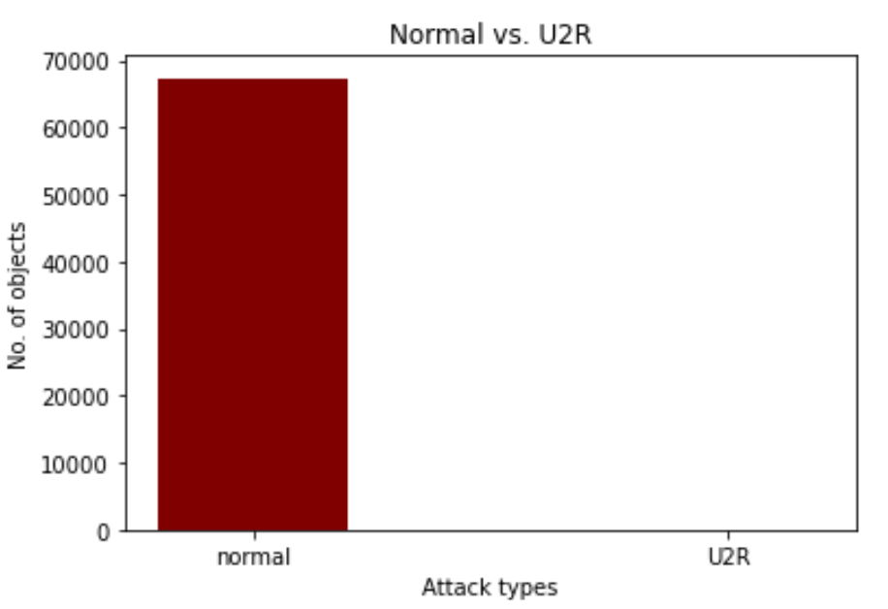
Class Balancing (Before)
Concordia

Slide 21
Techniques
Undersampling
Oversampling
SMOTE
Concordia

Slide 22
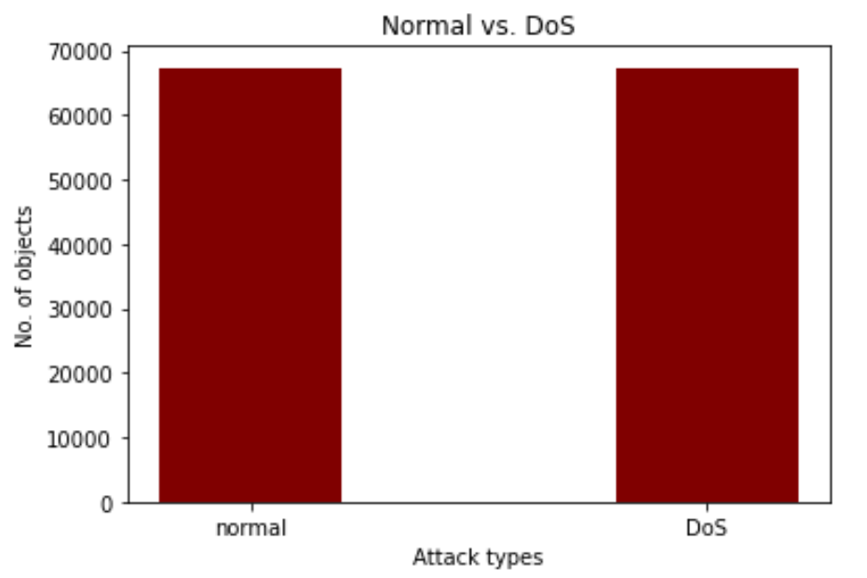
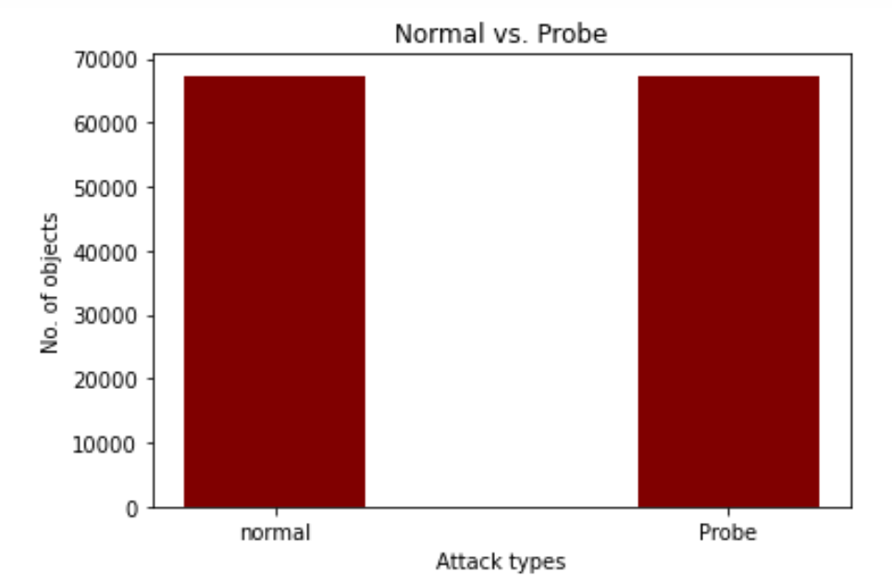
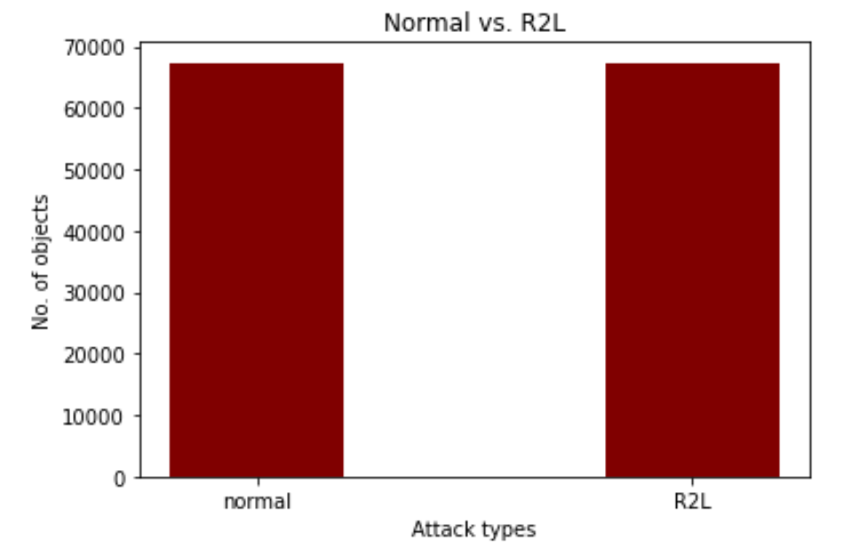

Class Balancing: SMOTE (After)
Concordia

Slide 23
Features Selection
4

Slide 24
SelectFromModel
LogisticRegression
SVM
RandomForest
LGBM
Extracted features
Extracted features
Extracted features
Extracted features
cv
Selected Features by at least 1 model
cv
Used Features
Concordia

Slide 25
Training & Testing
5

Slide 26
Models
K-Nearest Neighbor
Simple
Easy to implement
Slower as number of examples increase
Naïve Bayes
Assumption: all features independent
Works well with high-dimensional data
Less accurate
Concordia

Slide 27
Results
- Multi-class Problem -
Model | Accuracy | Precision | Recall | F1-measure
KNN | 0.97 | 0.962 | 0.89 | 0.915
NB | 0.53 | 0.133 | 0.25 | 0.173

Slide 28
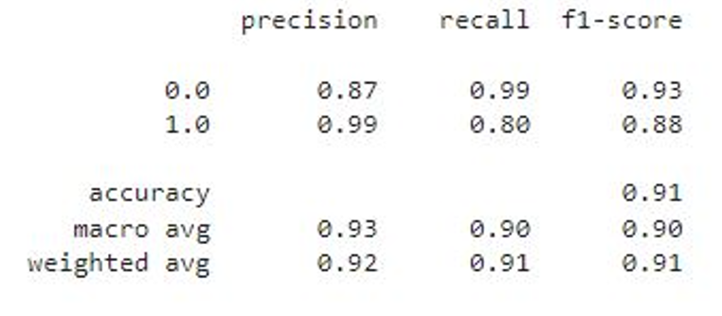
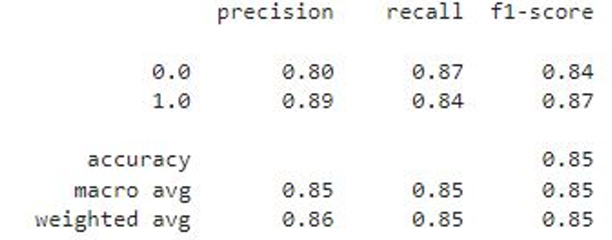
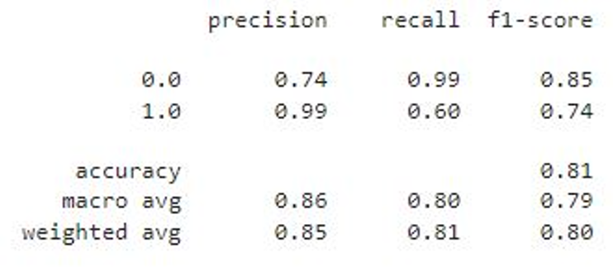
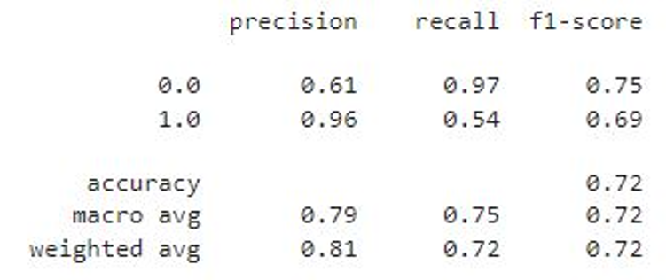
Results
- Binary Class Problem -
KNN - DoS
KNN - Probe
KNN – R2L
KNN – U2R
Notes:
We created 4 sub-datasets, we trained our model for each one of them

Slide 29
Conclusion
ML-based IDS that can be used for binary and multiclass problems
ML-based IDS focused decreasing negative alarms
ML-based IDS with different data mining algorithms
Concordia

Slide 30
THANKS!
Any questions?
Concordia

Slide 31
REFERENCES
Network Intrusion Detection System Using Neural Network and Condensed Nearest Neighbors
with Selection of NSL-KDD Influencing Features (The 2020 IEEE International Conference on
Internet of Things and Intelligence System (IoTaIS))
Implementing a Network Intrusion Detection System Using Semi-supervised Support Vector
Machine and Random Forest (ACM Southeast Conference – ACMSE 2021 – Session 2: Short
Papers – ISBN: 978-1-4503-8068-3 Virtual Event, USA, April 15-17, 2021)
Intrusion Detection System for NSL-KDD Dataset Using Convolutional Neural Networks
(Proceedings of the 2018 2nd International Conference on Computer Science and Artificial
Intelligence, December 2018)
A Network Intrusion Detection System Based on Categorical Boosting Technique using NSL-KDD
(Indian Journal of Cryptography and Network Security (IJCNS) ISSN: 2582-9238 (Online),
Volume-1 Issue-2, November 2021)
Towards a Standard Feature Set for Network Intrusion Detection System Datasets (Mobile
Networks and Applications https://doi.org/10.1007/s11036-021-01843-0, Accepted: 31 August
2021)
Concordia

